Slide 1
Interactive lecture hall in VRChat
Nomination: Nomination I
Team ABOBA
National Technical University of Ukraine “Igor Sikorsky Kyiv Polytechnic Institute”
Team members:
Denysiuk Dmytro, Shcherbak Yaroslav

Slide 2
Our Team
Dmytro Denysiuk
Faculty of Program Systems and Applied Mathematics
Role in the project:
3D modelling, design
Yaroslav Shcherbak
Faculty of Program Systems and Applied Mathematics
Role in the project:
VRChat development

Slide 3
Selected Location
SELECTED LOCATION
KPI Faculty of Informatics and Computing Technology (FICT), Building 18, Generalized Virtual Hub This virtual environment is a prototypical representation inspired by the modern educational and collaborative hubs within Building 18, primarily serving the Faculty of Informatics and Computing Technology. Rather than a 1:1 scan of a specific lab, it captures the layout and technical atmosphere of reconfigurable spaces.
MODELLED SCOPE
The central presentation and instructional zone, featuring the speaker's podium and reconfigurable seating for students.
The main presentation wall equipped with a large digital screen for educational materials and event branding.
Adapted interior architectural elements based on the real FICT Hub at KPI, including the side windows for natural lighting, entrance doors, and ceiling lights.

Slide 4
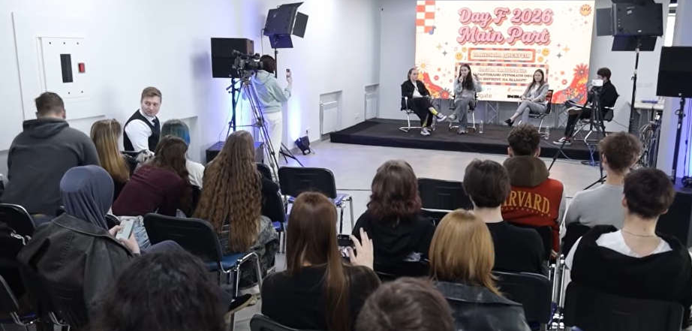
Selected Location

Slide 5
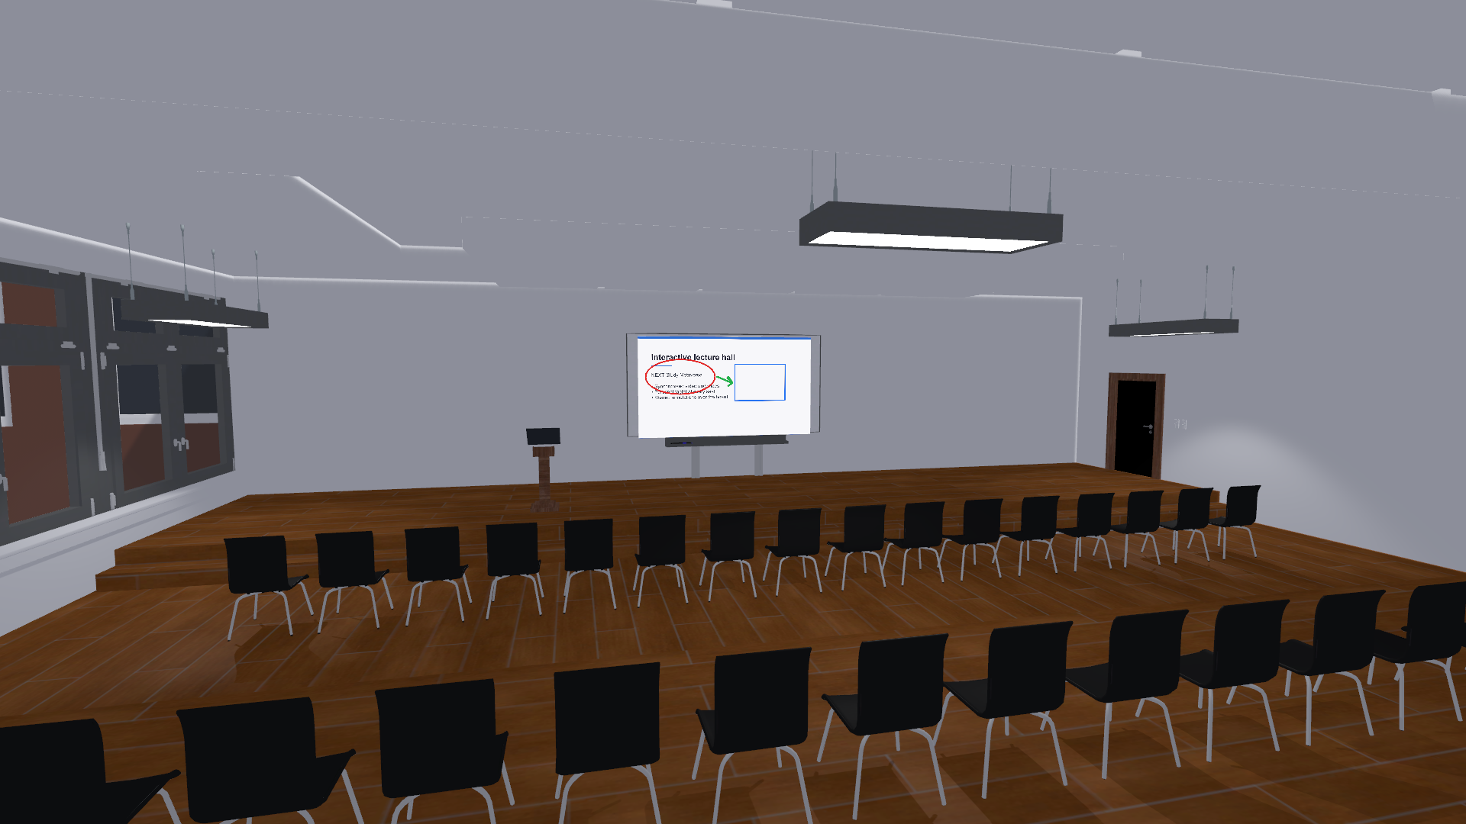
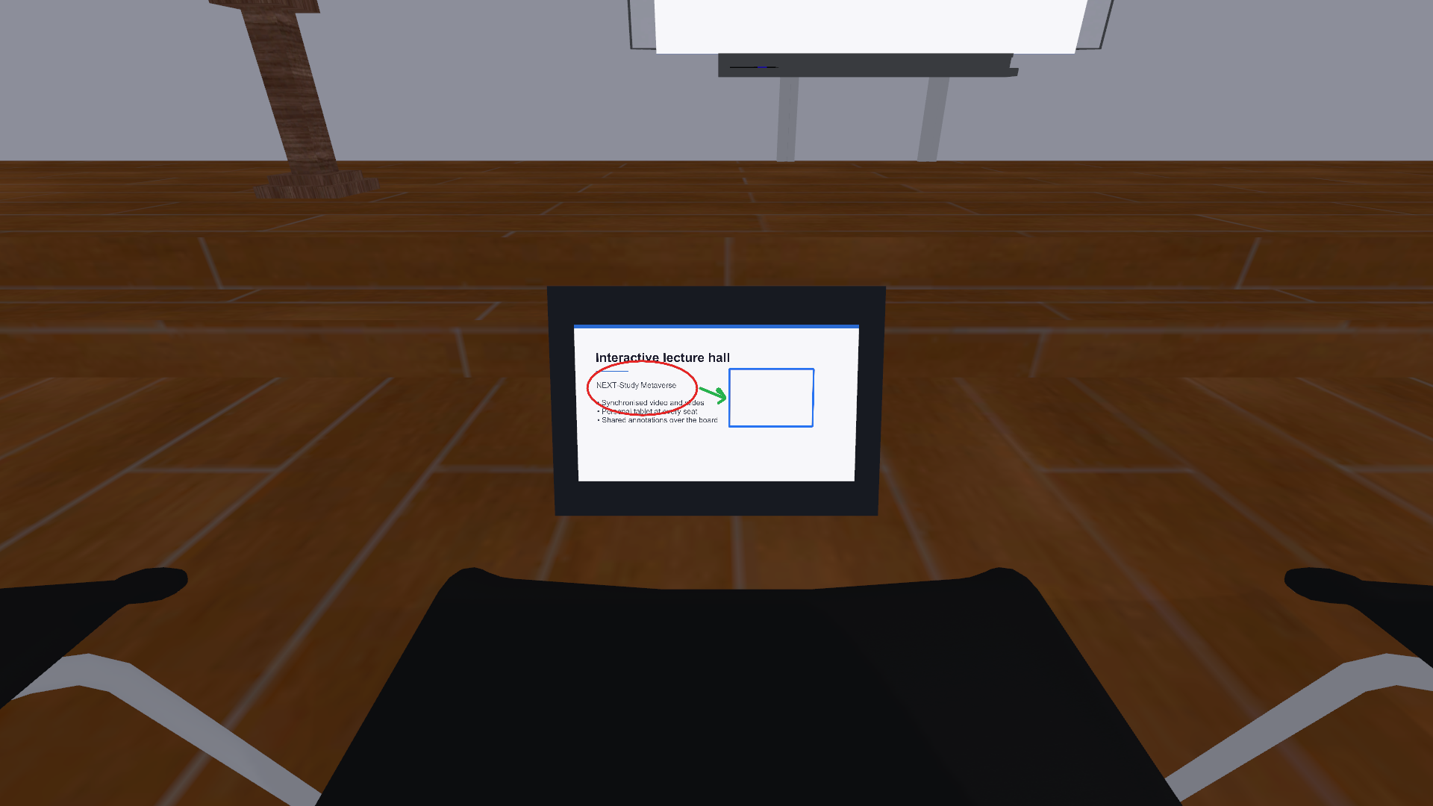
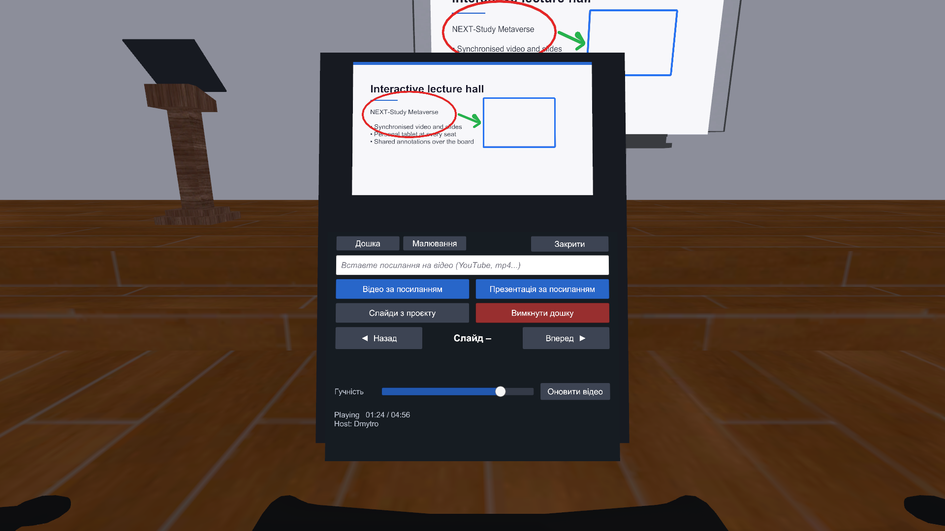
Virtual Model
The lecture hall rebuilt for VRChat: the presentation wall with an interactive board, the speaker's podium and 48 seats, each with its own tablet.

Slide 6
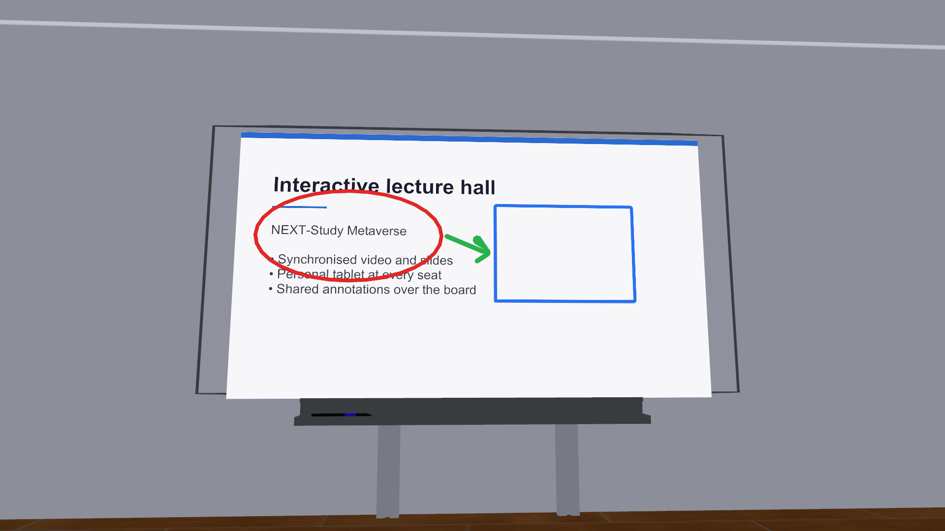
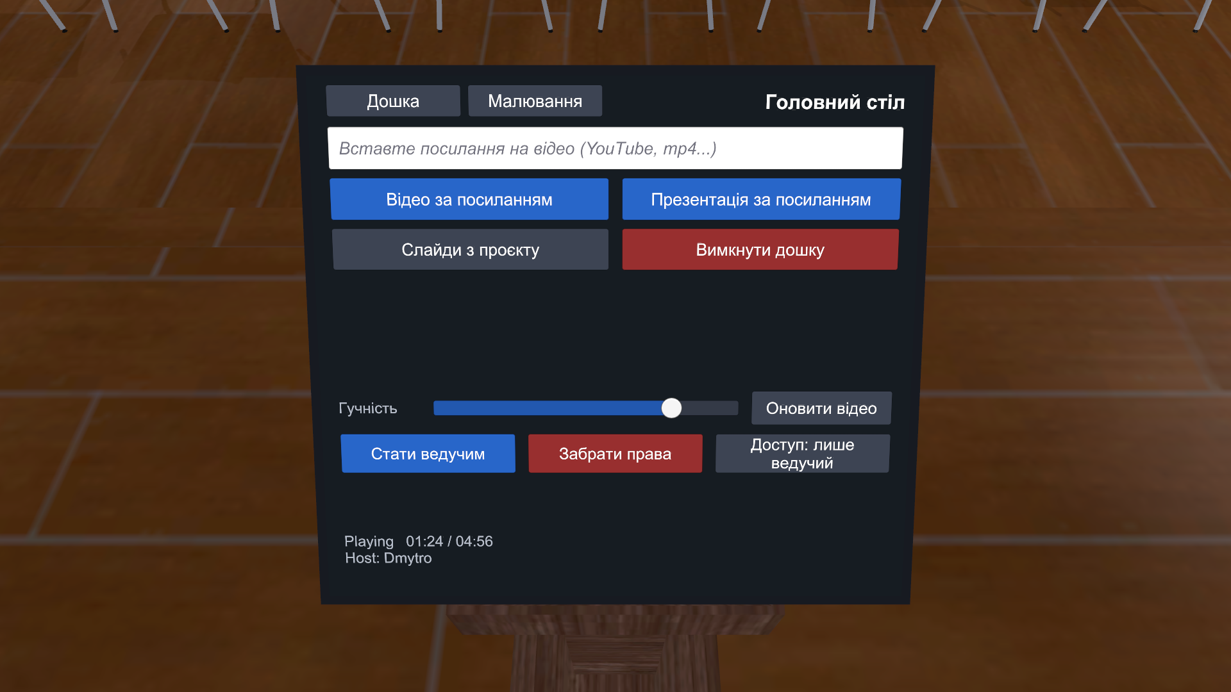
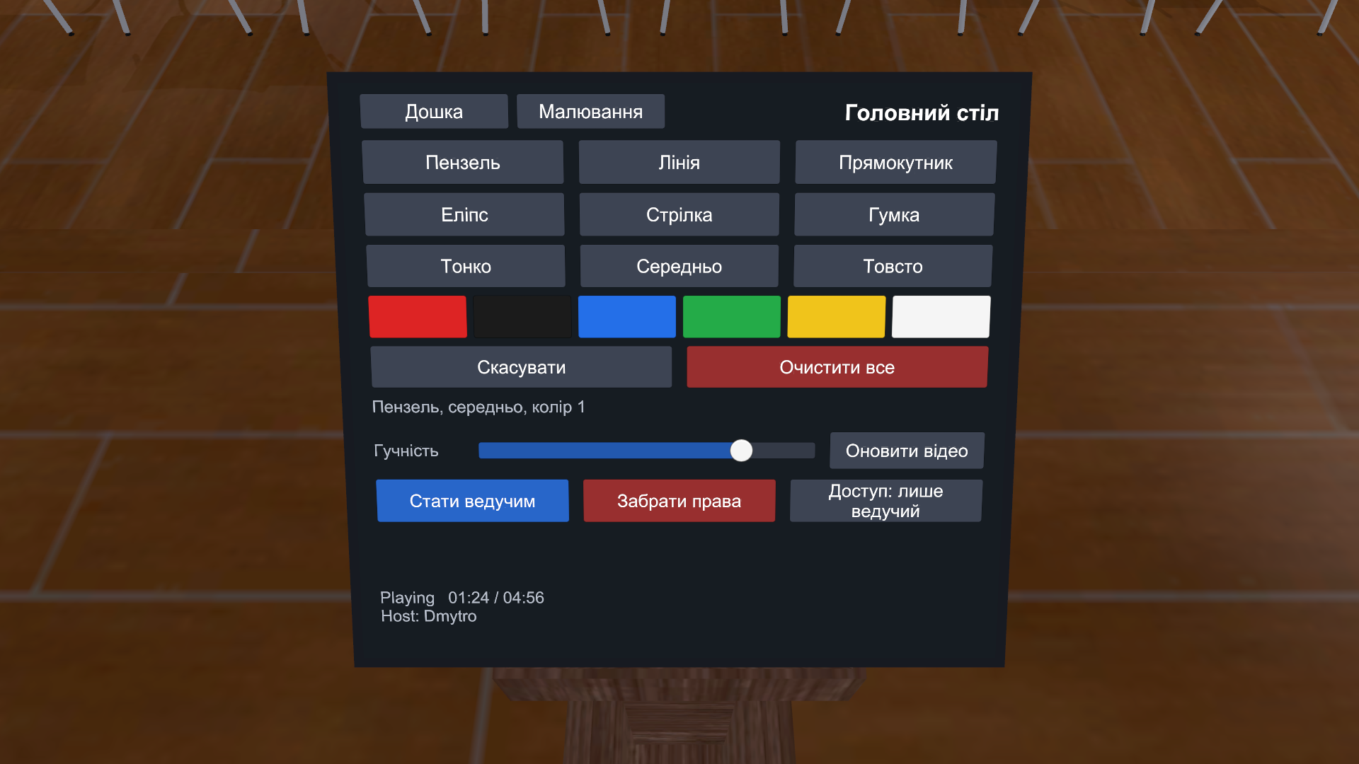
Digital Artefacts
Presentation board
Presenter's desk
Annotation layer
Plays video by URL, converted slide decks and images shipped with the world. Everyone sees the same frame; latecomers join at the current moment.
Controls the board and hands out presenter rights: a visitor sends a request, the desk grants it or takes it back.
Brush, shapes and eraser draw over the slide or video; strokes are shared and mirrored on the seat tablets.

Slide 7
Technical Implementation
Tools and software
Unity 2022.3.22f1, VRChat Worlds SDK 3.10 (Udon and UdonSharp), Blender for the hall and furniture, C# editor tooling, Git and GitHub.
Development process
The interior was modelled in Blender from reference photos, assembled and lit in Unity, and the interactive systems were written in UdonSharp. An editor script rebuilds the board, the desk panel, 48 seat tablets and the drawing area from a single menu command.
VRChat integration
Seats are VRChat stations, panels are world-space canvases, and video runs on the Unity player on PC and on AVPro in the Android build. Board state is synchronised manually, so a latecomer receives the current video, slide and drawing.
Technical challenges
Playback is aligned by a shared server-time offset instead of a timestamp, so every client seeks to the same moment. Control rights were moved to the desk after the first version let anyone press the buttons. A Play Mode test suite of 124 checks runs the world on both build targets.

Slide 8
Integration into NEXT-Study Metaverse
Educational use
Lectures, seminars and project defences: the teacher plays a video or slides, annotates them live on the board, and hands control to the student who presents next.
User experience
Visitors take a seat and get a personal tablet with the board close up: the same picture as everyone else, plus a request for presenter rights to show their own material or draw.
Further development
Text labels on the board, saving annotated slides, breakout zones for group work, a Quest-optimised build and state that survives between sessions.

Slide 9
Demo and Project Materials
Project demo
The world is built from the repository below: Unity 2022.3.22f1 with VRChat Worlds SDK 3.10, scene Assets/Scenes/VRCDefaultWorldScene.unity.
Project materials
https://github.com/Dimon0101/NextMetaversProject

Slide 10
Thank you!
Questions?

